Slide 1

8th Grade Math: Pre-Algebra
Unit 5, Lesson 7 Using the Pythagorean Theorem to Solve Real-World Problems Volume 1, pg. 208

Slide 2


Benchmark
MA.8.GR.1.1
Apply the Pythagorean Theorem to solve mathematical and real-world problems involving unknown side lengths in right triangles.
volume 1, pg. 208

Slide 3
Integrated Mathematical Thinking and Reasoning Standards
MA.K12.MTR.1.1 Actively participate in effortful learning both individually and collectively.
MA.K12.MTR.3.1 Complete tasks with mathematical fluency.
MA.K12.MTR.4.1 Engage in discussions that reflect on the mathematical thinking of self and others.
MA.K12.MTR.5.1 Use patterns and structure to help understand and connect mathematical concepts.
MA.K12.MTR.7.1 Apply mathematics to real-world contexts.
volume 1, pg. 208

Slide 4

Learning Target
I can solve real-world problems by applying the Pythagorean Theorem.
volume 1, pg. 208

Slide 5

Warm-Up
volume 1, pg. 209

Slide 6
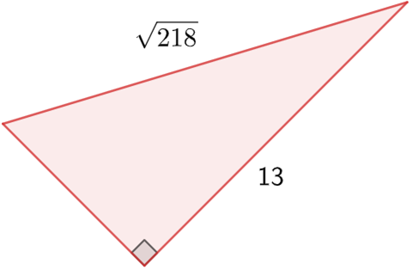

5.7.1 Warm-Up: Bell Work
Sawyer applied the Pythagorean Theorem to find the length of the missing side of the triangle. His work is shown.
Write a note to Sawyer explaining his mistake.
$$a^{2}+b^{2}=c^{2}$$
$${13}^{2}+{\sqrt{218}}^{2}=c^{2}$$
$$169+218=c^{2}$$
$$387=c^{2}$$
$$\sqrt{387}=c$$
The missing side is $\sqrt{387}$ units long.
Correct Sawyer’s mistake.
volume 1, pg. 209

Slide 7

Collaboration
volume 1, pg. 209

Slide 8

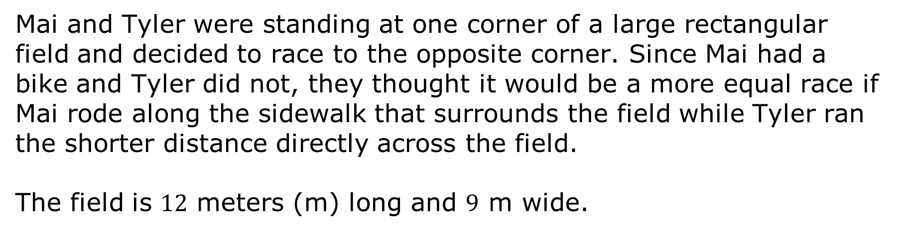
5.7.2 Collaboration: Who Wins?
Mai and Tyler were standing at one corner of a large rectangular field and decided to race to the opposite corner. Since Mai had a bike and Tyler did not, they thought it would be a more equal race if Mai rode along the sidewalk that surrounds the field while Tyler ran the shorter distance directly across the field.
The field is $12$ meters (m) long and $9$ m wide.
volume 1, pg. 209

Slide 9
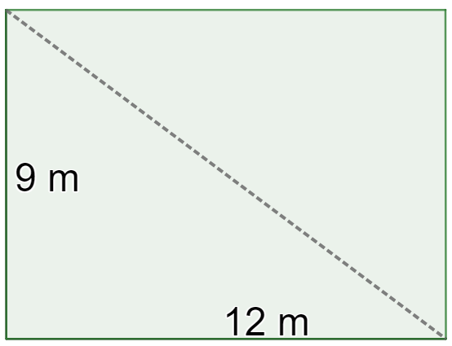

Tyler can run at around $5$ m per second, and Mai can ride her bike at around $7.5$ m per second.
Before making any calculations, predict who you think will win and by how much. Show or explain your thinking.
Work with your partner to mathematically determine who will win the race.
volume 1, pg. 209

Slide 10

Guided Instruction
volume 1, pg. 210

Slide 11
5.7.3 Guided Instruction: Applying the Pythagorean Theorem
The Pythagorean Theorem can be used to find an unknown side length of any right triangle.
Pythagorean Theorem Problem-Solving Steps
Model the problem with a diagram (if not provided).
State the Pythagorean Theorem.
Substitute given values.
Solve for the unknown.
volume 1, pg. 210

Slide 12
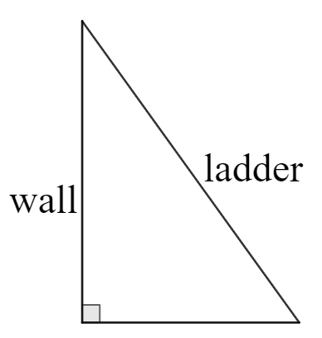
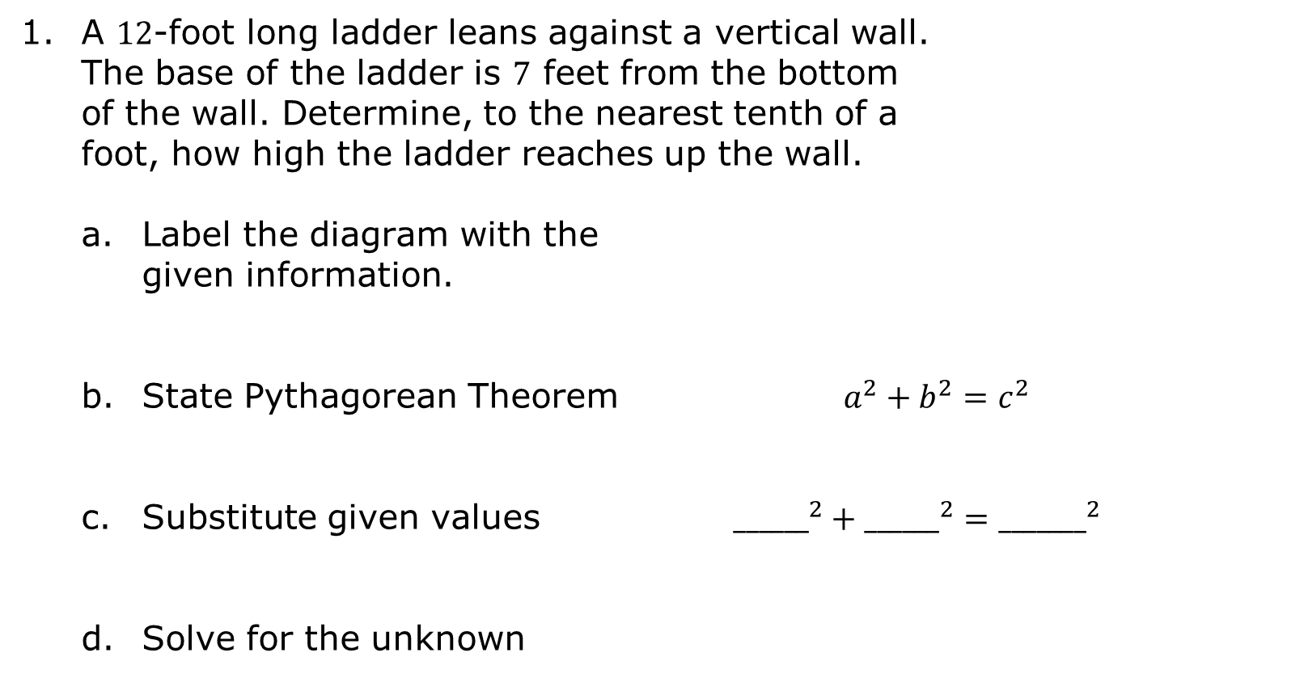
A $12$-foot long ladder leans against a vertical wall. The base of the ladder is $7$ feet from the bottom of the wall. Determine, to the nearest tenth of a foot, how high the ladder reaches up the wall.
Label the diagram with the given information.
State Pythagorean Theorem $a^{2}+b^{2}=c^{2}$
Substitute given values ${______}^{2}+{______}^{2}={_______}^{2}$
Solve for the unknown
volume 1, pg. 210

Slide 13
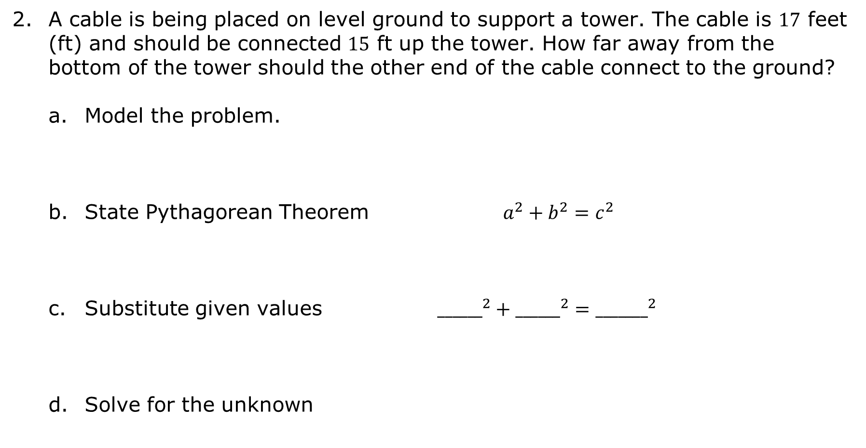
A cable is being placed on level ground to support a tower. The cable is $17$ feet (ft) and should be connected $15$ ft up the tower. How far away from the bottom of the tower should the other end of the cable connect to the ground?
Model the problem.
State Pythagorean Theorem $a^{2}+b^{2}=c^{2}$
Substitute given values ${______}^{2}+{______}^{2}={_______}^{2}$
Solve for the unknown
volume 1, pg. 211

Slide 14
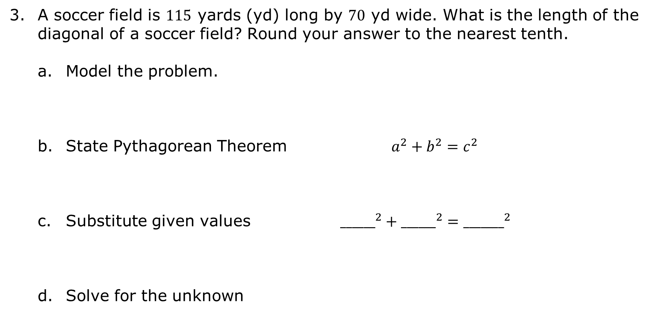
A soccer field is $115$ yards (yd) long by $70$ yd wide. What is the length of the diagonal of a soccer field? Round your answer to the nearest tenth.
Model the problem.
State Pythagorean Theorem $a^{2}+b^{2}=c^{2}$
Substitute given values ${______}^{2}+{______}^{2}={_______}^{2}$
Solve for the unknown
volume 1, pg. 211

Slide 15

Guided Practice
volume 1, pg. 212

Slide 16

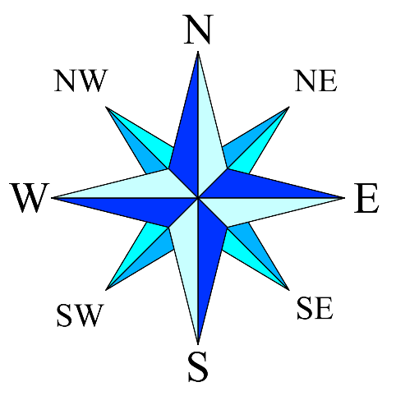
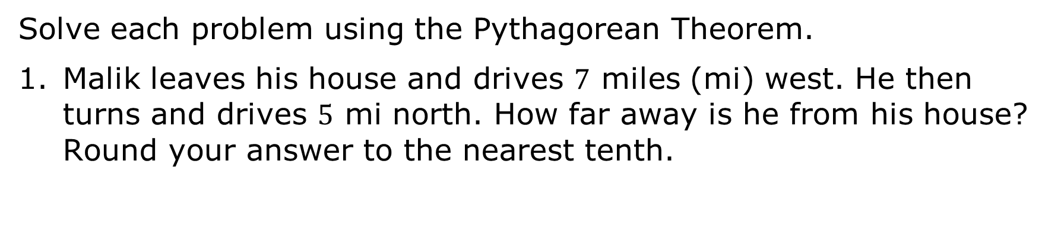
5.7.4 Guided Practice: Applying the Pythagorean Theorem
Solve each problem using the Pythagorean Theorem.
Malik leaves his house and drives $7$ miles (mi) west. He then turns and drives $5$ mi north. How far away is he from his house? Round your answer to the nearest tenth.
volume 1, pg. 212

Slide 17
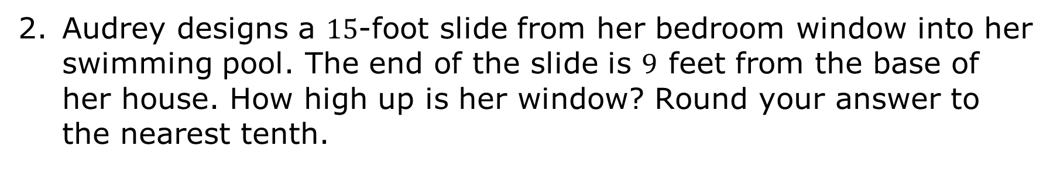
Audrey designs a $15$-foot slide from her bedroom window into her swimming pool. The end of the slide is $9$ feet from the base of her house. How high up is her window? Round your answer to the nearest tenth.
volume 1, pg. 212

Slide 18
Collaboration
volume 1, pg. 212

Slide 19
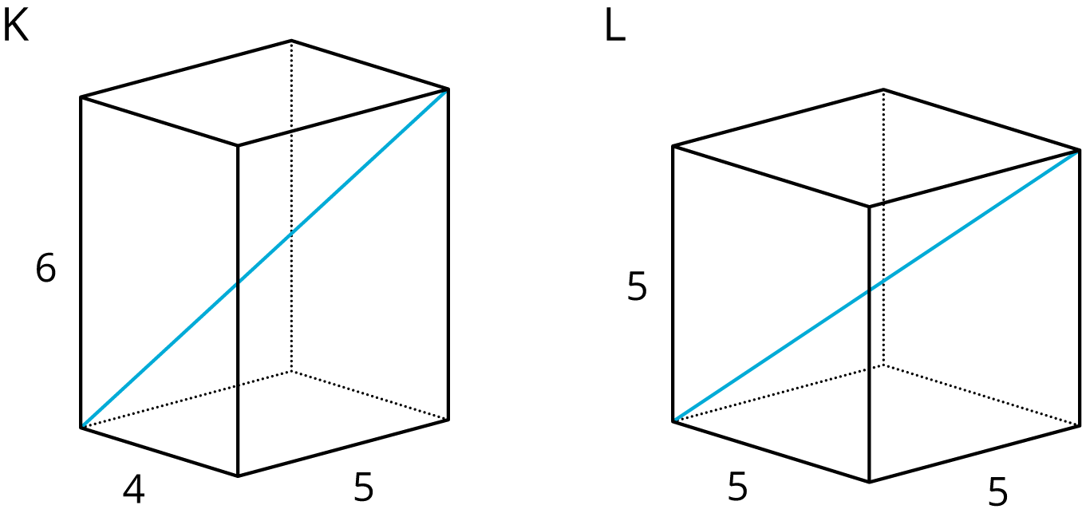
5.7.5 Collaboration: Internal Dimensions
Two rectangular prisms are shown:
Predict which figure has a longer diagonal. Note that the figures are not drawn to scale.
Discuss with your partner if there is enough information to find the diagonal using the Pythagorean Theorem. Summarize your discussion.
volume 1, pg. 212

Slide 20
What other measurement must be calculated first to find the diagonal? Label this extra measurement on the figures above.
Find the exact length of the base diagonals using the Pythagorean Theorem.
Use the Pythagorean Theorem to calculate the length of both diagonals. Which one is longer?
volume 1, pg. 213

Slide 21

Your Turn
volume 1, pg. 213

Slide 22
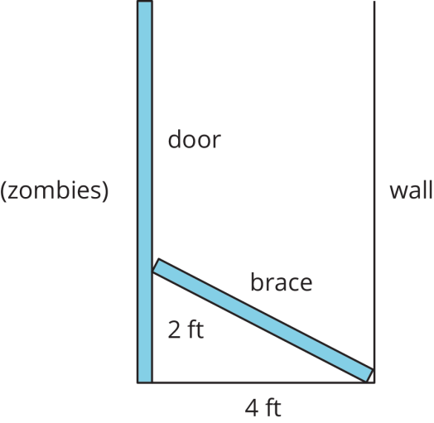
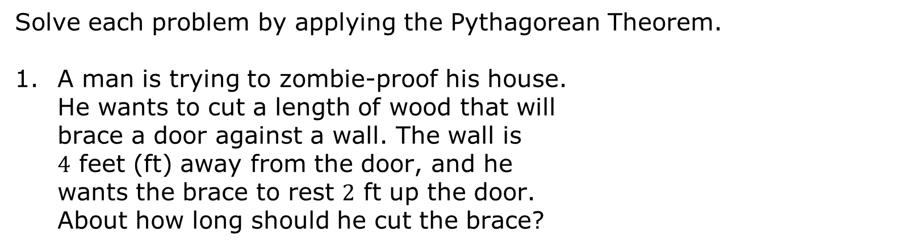
5.7.6 Your Turn!
Solve each problem by applying the Pythagorean Theorem.
A man is trying to zombie-proof his house. He wants to cut a length of wood that will brace a door against a wall. The wall is $4$ feet (ft) away from the door, and he wants the brace to rest $2$ ft up the door. About how long should he cut the brace?
volume 1, pg. 213

Slide 23
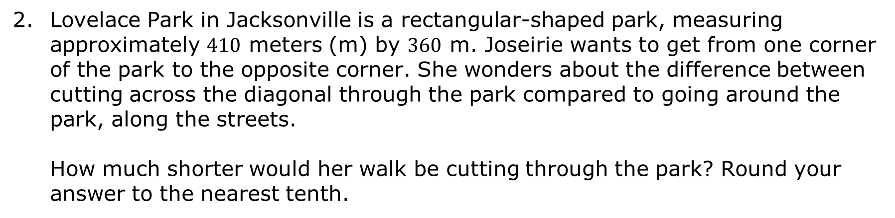
Lovelace Park in Jacksonville is a rectangular-shaped park, measuring approximately $410$ meters (m) by $360$ m. Joseirie wants to get from one corner of the park to the opposite corner. She wonders about the difference between cutting across the diagonal through the park compared to going around the park, along the streets.
How much shorter would her walk be cutting through the park? Round your answer to the nearest tenth.
volume 1, pg. 213

Slide 24
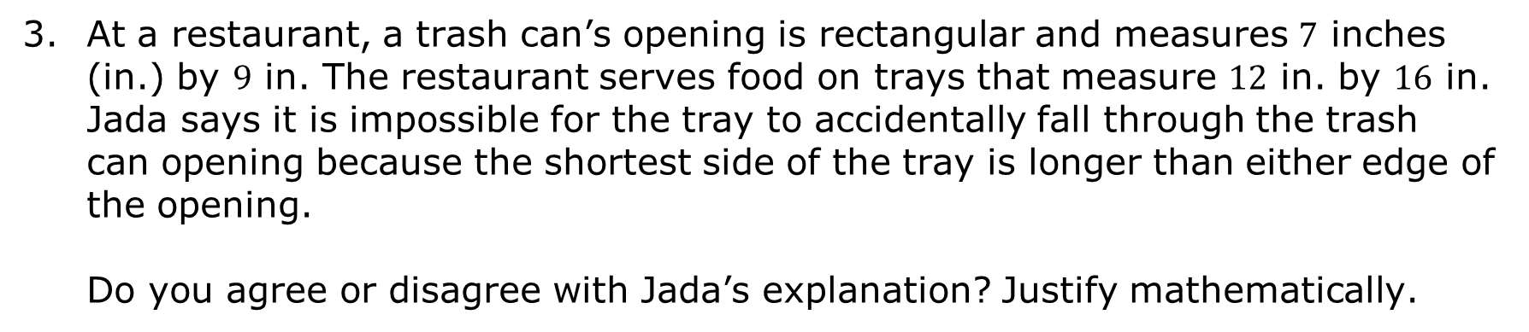
At a restaurant, a trash can’s opening is rectangular and measures $7$ inches (in.) by $9$ in. The restaurant serves food on trays that measure $12$ in. by $16$ in. Jada says it is impossible for the tray to accidentally fall through the trash can opening because the shortest side of the tray is longer than either edge of the opening.
Do you agree or disagree with Jada’s explanation? Justify mathematically.
volume 1, pg. 214

Slide 25

Wrap-Up
volume 1, pg. 214

Slide 26
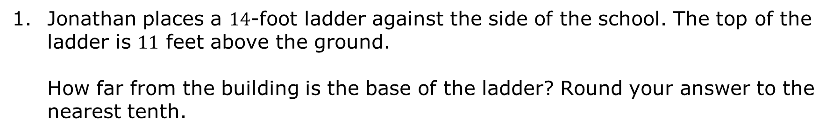
5.7.7 Wrap-Up: Ticket Out the Door
Jonathan places a $14$-foot ladder against the side of the school. The top of the ladder is $11$ feet above the ground. How far from the building is the base of the ladder? Round your answer to the nearest tenth.
volume 1, pg. 214

